Slide 1





Slide 2
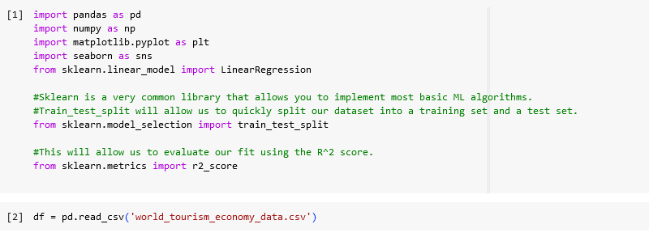
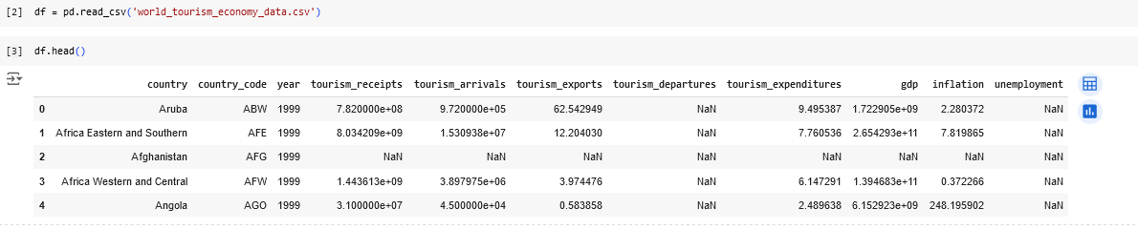
Import libraries and modules :

Slide 3
Data Description:
The dataset consists of one CSV file named "world_tourism_economy_data.csv" with the following columns:
country: The name of the country for which the data is reported.
country code: ISO country code (e.g., USA).
year: The year for which the data is reported (1999-2023).
tourism receipts: Income from international tourism (in current US dollars).
tourism arrivals: Number of international tourists arriving in the country.
tourism exports: Share of exports derived from international tourism receipts (%).
tourism departures: Number of residents traveling abroad for tourism.
tourism expenditures: Spending by international tourists (in current US dollars).
gap: Gross Domestic Product of the country (in current US dollars).
inflation: Annual percentage change in the price level (inflation).
unemployment: Percentage of the labor force that is unemployed but actively seeking work.

Slide 4
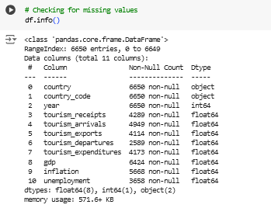
Checking for missing values:
EDA:

Slide 5
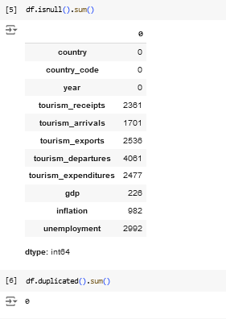
Count the missing values:
EDA :

Slide 6
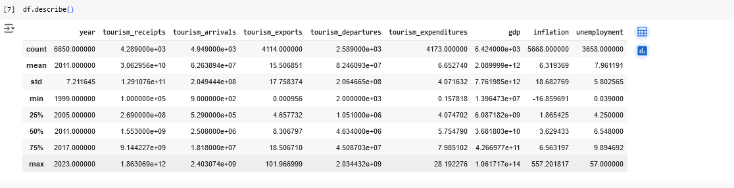
Describe the data:
EDA :

Slide 7
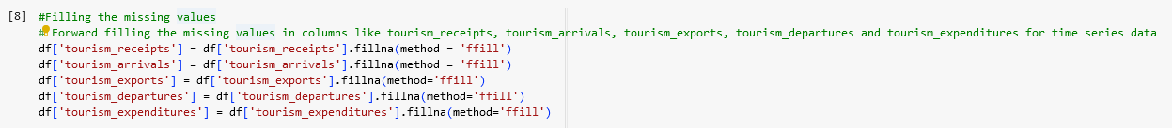
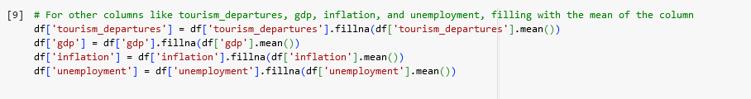
Filling the missing values forward filling:
Data Preprocessing:
Filling the missing values using mean:

Slide 8
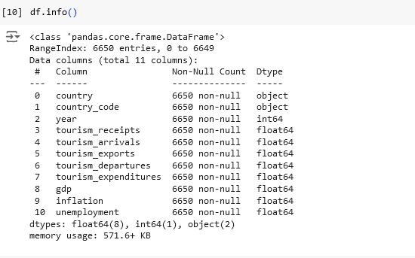
Ensuring that the data does not contain any missing values:
Data Preprocessing:

Slide 9
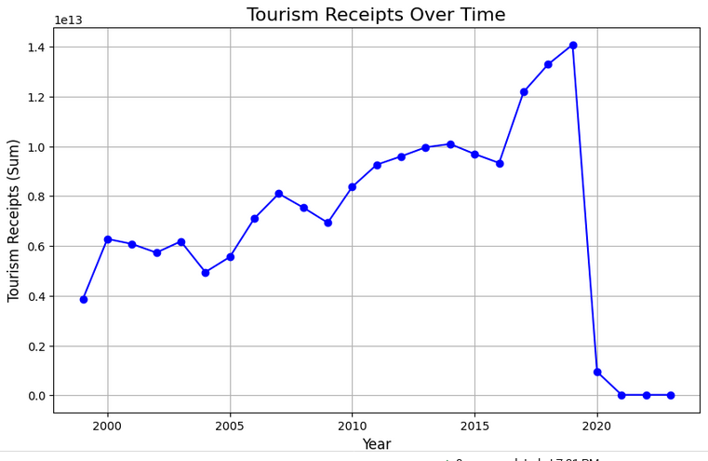
How do total tourism receipts change over the years?

Slide 10
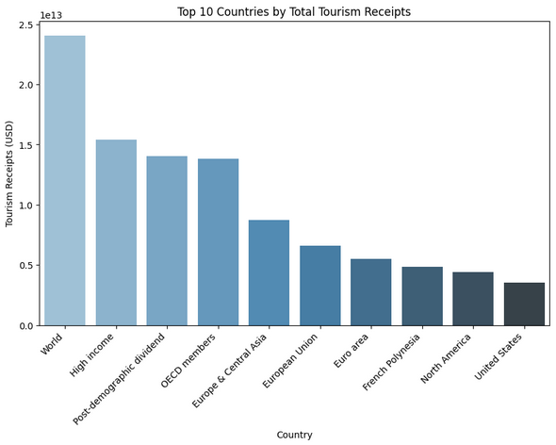
Which countries are the top 10 contributors to total tourism receipts, and how do they compare in terms of revenue?

Slide 11
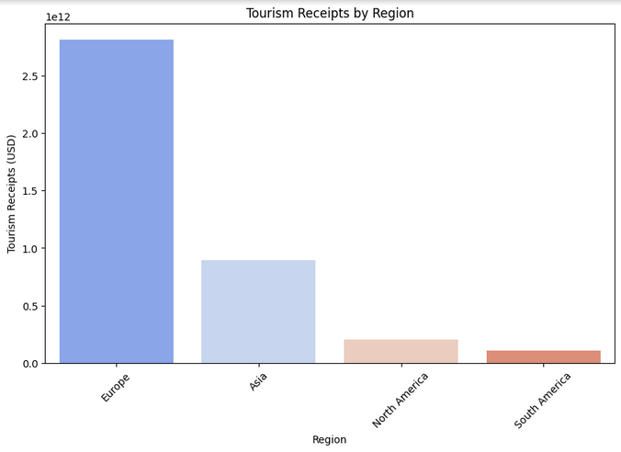
How do tourism receipts vary across different regions, and which region generates the highest total receipts?

Slide 12
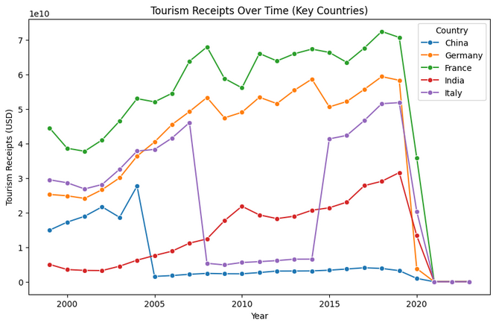
How have tourism receipts changed over time for key countries, and how do these countries compare in their trends?

Slide 13
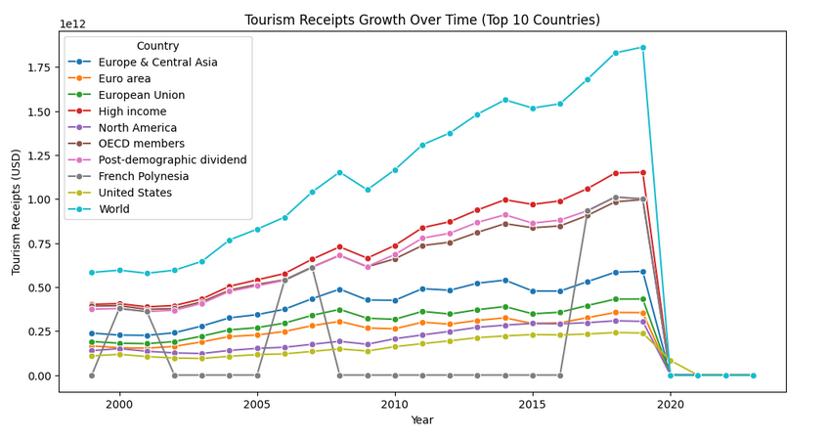
How have tourism receipts evolved over time for the top 10 countries, and what differences can be observed in their growth trends?

Slide 14
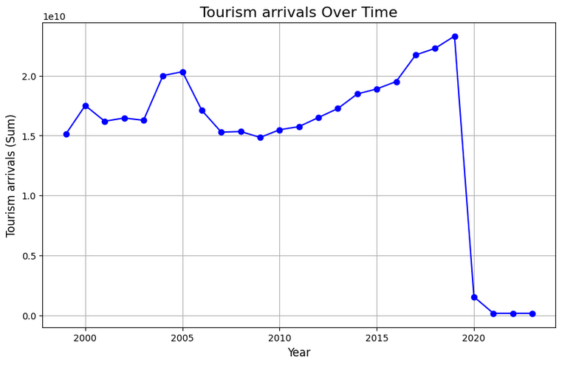
How have total tourism arrivals changed over the years, and what trends or patterns can be observed?

Slide 15
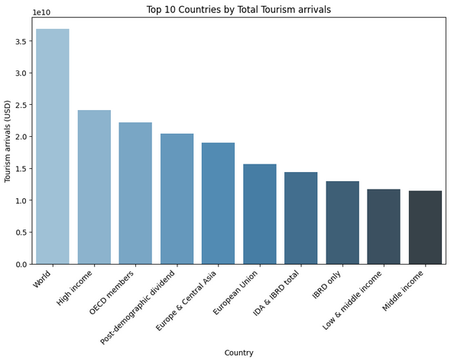
Which countries are the top 10 destinations in terms of total tourism arrivals, and how do their numbers compare?

Slide 16
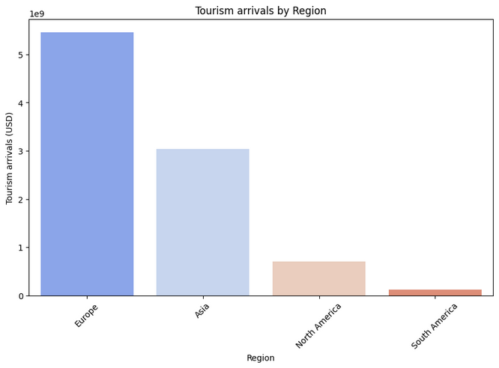
How do tourism arrivals vary across different regions, and which region attracts the highest number of tourists?

Slide 17
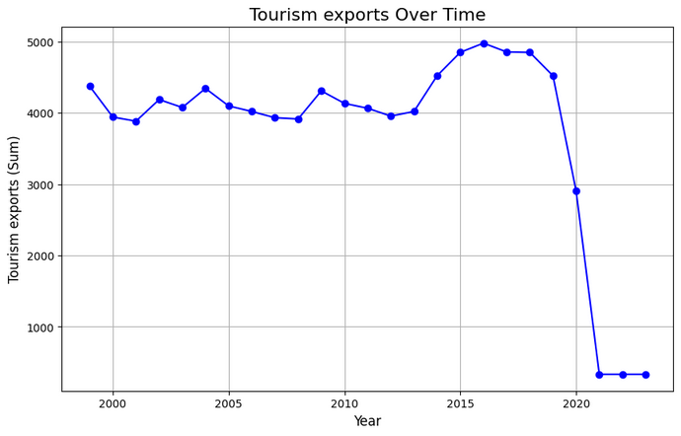
How have total tourism exports changed over the years, and what trends or patterns can be observed?

Slide 18
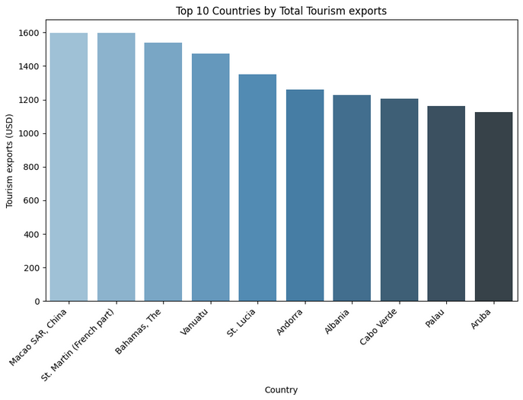
Which countries are the top 10 exporters of tourism, and how do their export values compare?

Slide 19
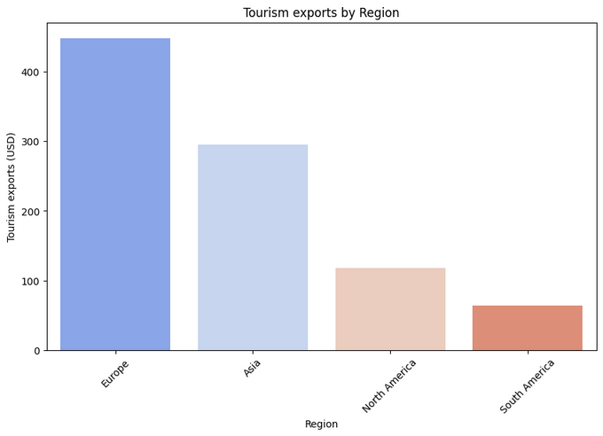
How do tourism exports vary across different regions, and which region generates the highest tourism export values?

Slide 20
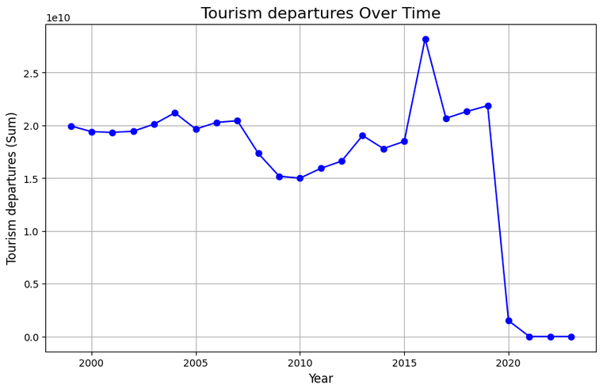
How have tourism departures changed over the years, and what trends or patterns can be observed in the data?

Slide 21
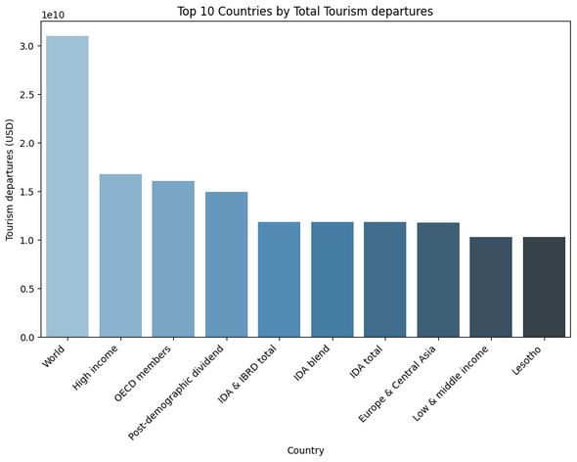
Which countries are the top 10 in terms of total tourism departures, and how do their departure numbers compare?

Slide 22
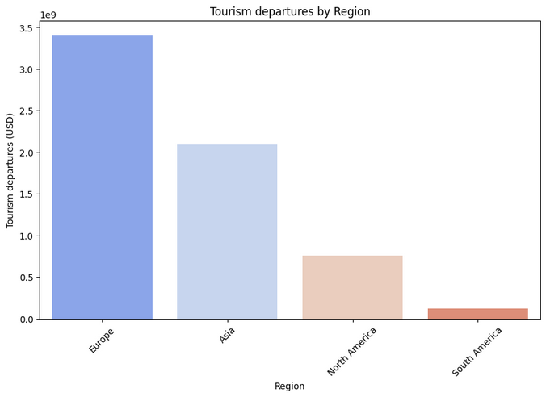
How do tourism departures vary across different regions, and which region has the highest total tourism departures?

Slide 23
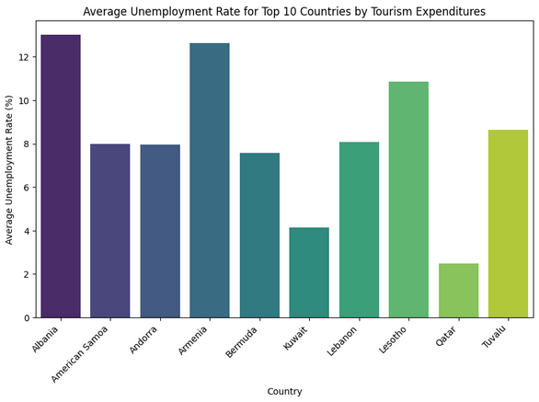
What is the relationship between tourism expenditures and average unemployment rates in the top 10 countries by tourism expenditures?

Slide 24
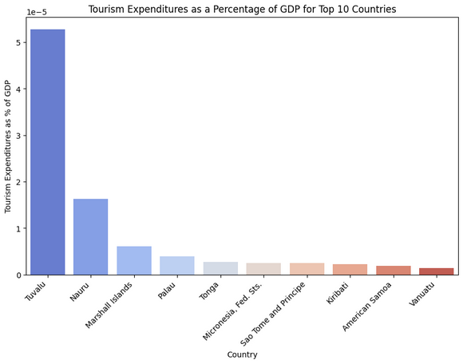
Which countries have the highest tourism expenditures as a percentage of GDP, and how do they compare?

Slide 25
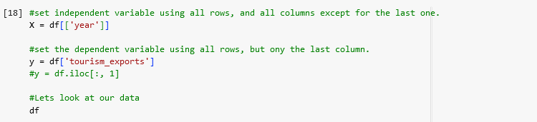
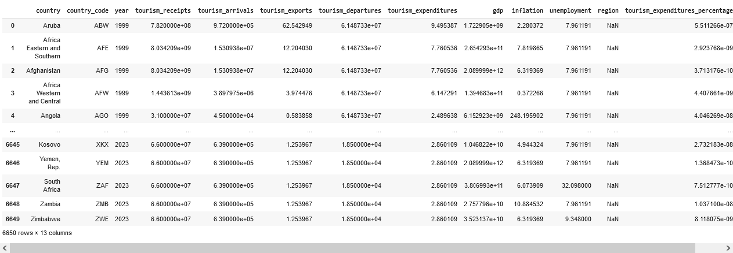
set independent variable using all rows, and all columns except for the last one: set the dependent variable using all rows, but only the last column:

Slide 26
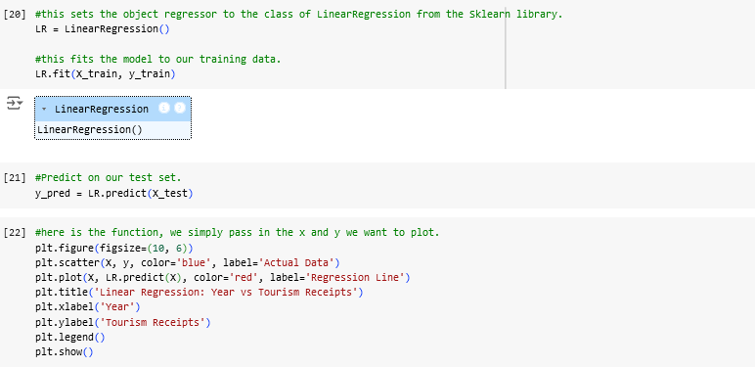
sets the object repressor to the class of Linear Regression.
fits the model to our training data.

Slide 27
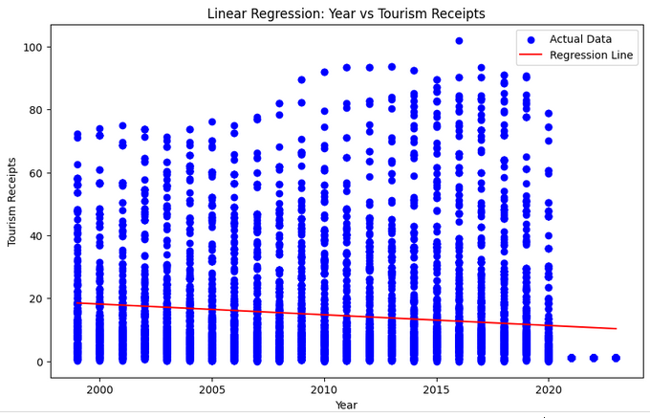
Visualization of the trend in tourism receipts over the years, with the regression line helping to understand the overall pattern or relationship between the year and tourism receipts.

Slide 28
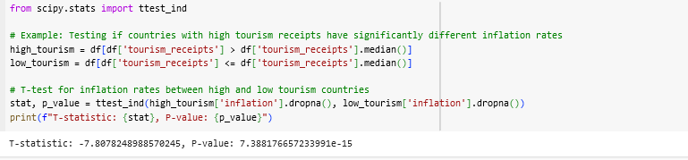
Testing if countries with high tourism receipts have significantly different inflation rates:

Slide 29
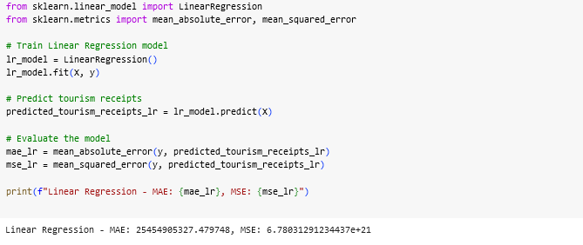
Evaluate the model

Slide 30


